Slide 1
Community Detection in Graphs, by Santo Fortunato
Presented by:
Yiye Ruan
Monadhika Sharma
Yu-Keng Shih

Slide 2
Outline
Sec. 1~5, 9: Yiye
Sec. 6~8: Monadhika
Sec 11~13,15: Yu-Keng
Sec 17: All (17.1: Yu-Keng 17.2: Yiye and Monadhika)

Slide 3
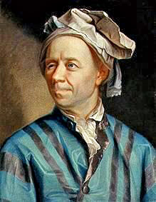
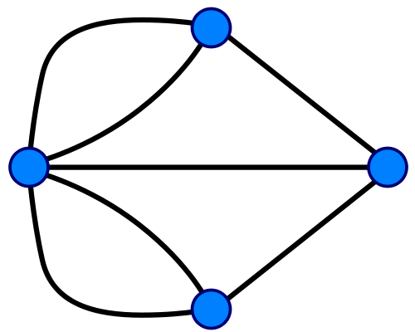

Graphs from the Real World
Königsberg's Bridges
Ref: http://en.wikipedia.org/wiki/Seven_Bridges_of_K%C3%B6nigsberg

Slide 4
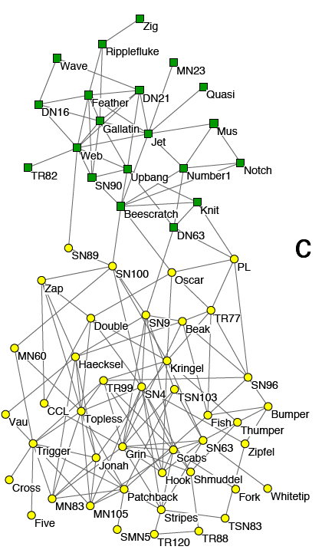
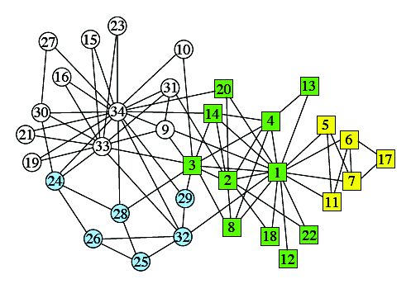
Graphs from the Real World
Zachary’s Karate Club
Lusseau’s network of bottlenose dolphins

Slide 5
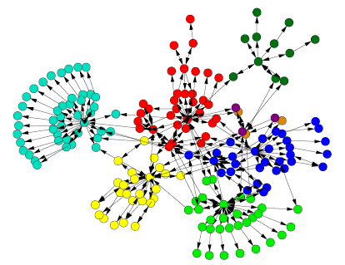
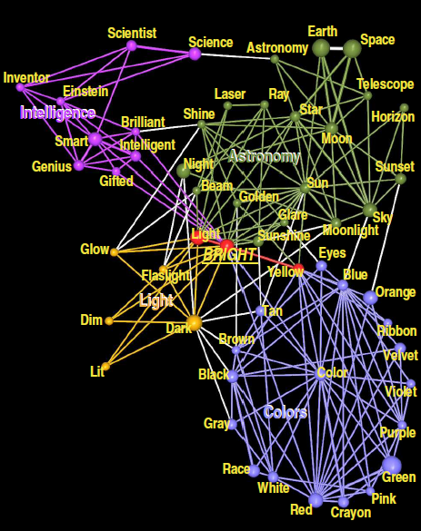
Graphs from the Real Word
Webpage Hyperlink Graph
Directed Communities
Network of Word Associations
Overlapping Communities

Slide 6
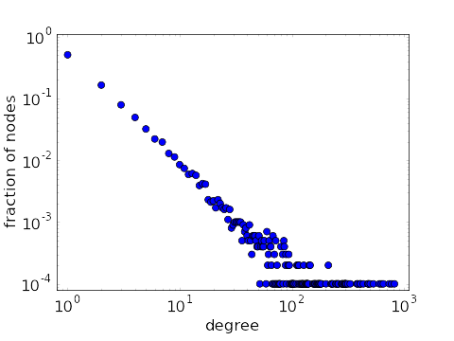
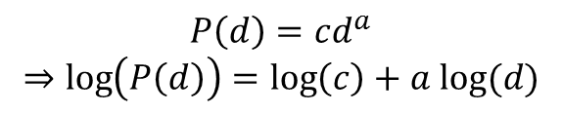
Real Networks Are Not Random
Degree distribution is broad, and often has a tail following power-law distribution
$$P\left(d\right)=cd^{a}$$
$$⇒\log\left(P\left(d\right)\right)=\log\left(c\right)+a log⁡(d)$$
Ref: “Plot of power-law degree distribution on log-log scale.” From Math Insight. http://mathinsight.org/image/power_law_degree_distribution_scatter

Slide 7
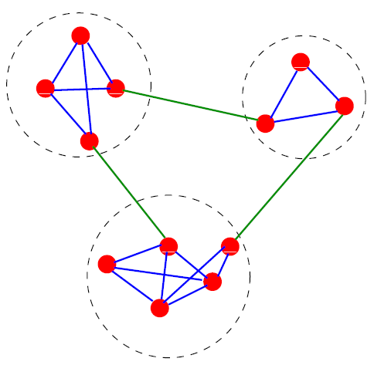
Real Networks Are Not Random
Edge distribution is locally inhomogeneous
Community Structure!

Slide 8
Applications of Community Detection
Website mirror server assignment
Recommendation system
Social network role detection
Functional module in biological networks
Graph coarsening and summarization
Network hierarchy inference

Slide 9
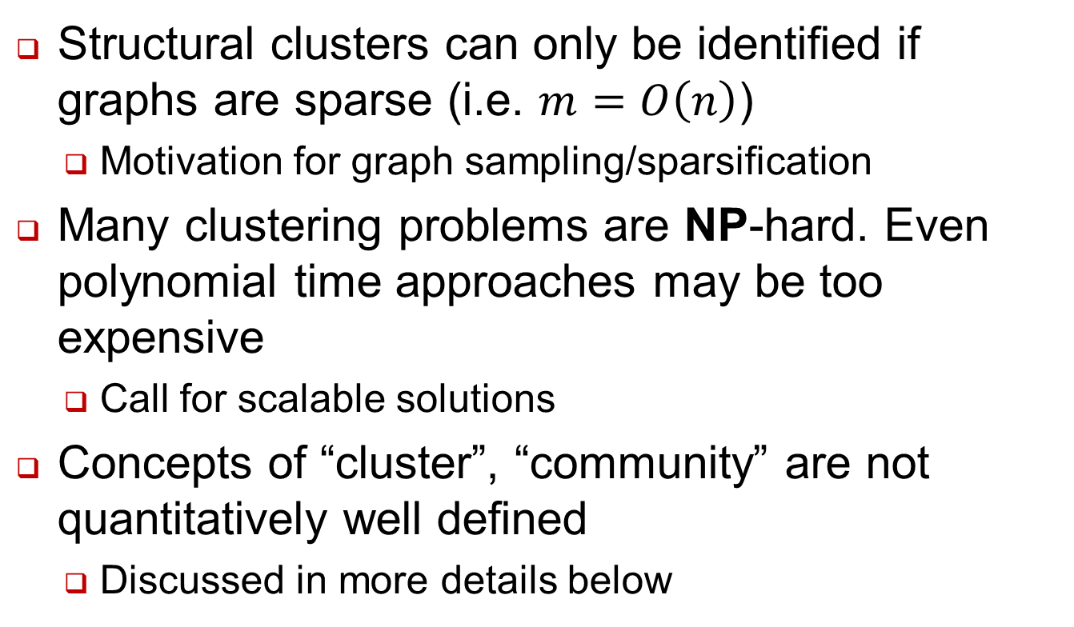
General Challenges
Structural clusters can only be identified if graphs are sparse (i.e. $m=O\left(n\right)$)
Motivation for graph sampling/sparsification
Many clustering problems are NP-hard. Even polynomial time approaches may be too expensive
Call for scalable solutions
Concepts of “cluster”, “community” are not quantitatively well defined
Discussed in more details below

Slide 10
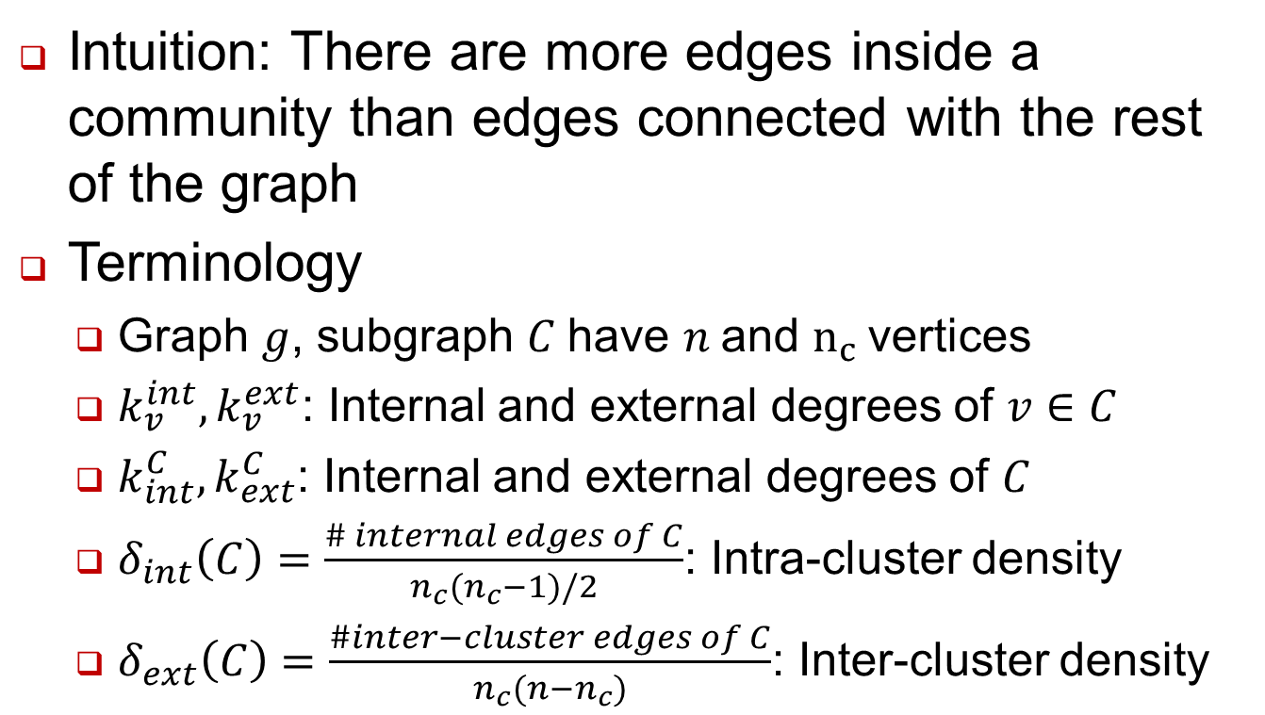
Defining Communities (Sec. 3)
Intuition: There are more edges inside a community than edges connected with the rest of the graph
Terminology
Graph $g$, subgraph $C$have $n$and $n_{c}$vertices
$k_{v}^{int}, k_{v}^{ext}$: Internal and external degrees of $v∈C$
$k_{int}^{C}, k_{ext}^{C}$: Internal and external degrees of $C$
$δ_{int}\left(C\right)=\frac{\# internal edges of C}{n_{c}(n_{c}−1)/2}$: Intra-cluster density
$δ_{ext}\left(C\right)=\frac{\#inter−cluster edges of C}{n_{c}(n−n_{c})}$: Inter-cluster density

Slide 11
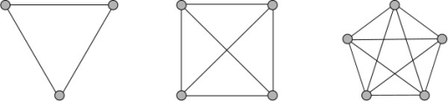
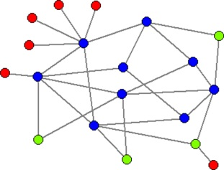
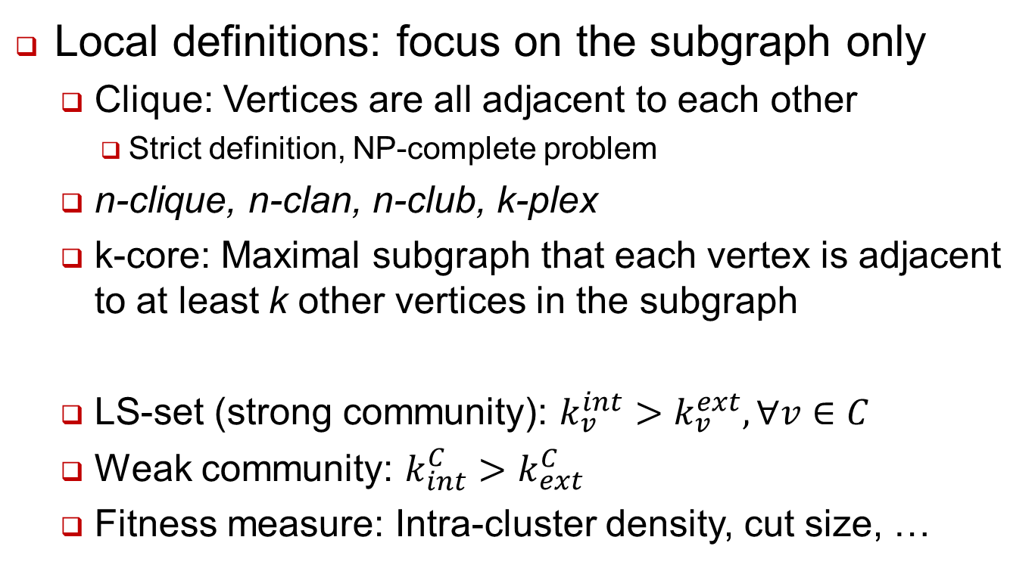
Defining Communities (Sec. 3)
Local definitions: focus on the subgraph only
Clique: Vertices are all adjacent to each other
Strict definition, NP-complete problem
n-clique, n-clan, n-club, k-plex
k-core: Maximal subgraph that each vertex is adjacent to at least k other vertices in the subgraph
LS-set (strong community): $k_{v}^{int}>k_{v}^{ext}, ∀v∈C$
Weak community: $k_{int}^{C}>k_{ext}^{C}$
Fitness measure: Intra-cluster density, cut size, …
Image ref: László, Zahoránszky, et al. "Breaking the hierarchy-a new cluster selection mechanism for hierarchical clustering methods." Algorithms for Molecular Biology 4.
Zhao, Jing, et al. "Insights into the pathogenesis of axial spondyloarthropathy from network and pathway analysis." BMC Systems Biology 6.Suppl 1 (2012): S4.

Slide 12
Defining Communities (Sec. 3)
Global definition: with respect to the whole graph
Null model: A random graph where some structure properties are matched with the original graph
Intuition: A subgraph is a community if the number of internal edges exceeds the expectation over all realizations of the null model
Modularity

Slide 13
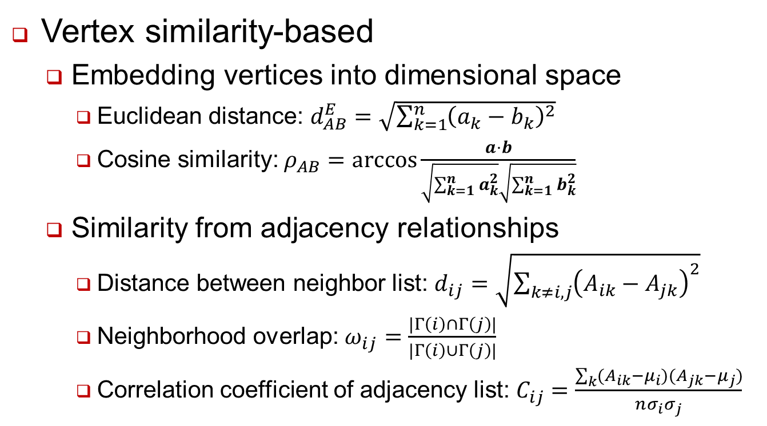
Defining Communities (Sec. 3)
Vertex similarity-based
Embedding vertices into dimensional space
Euclidean distance: $d_{AB}^{E}=\sqrt{\sum_{k=1}^{n}{{\left(a_{k}−b_{k}\right)}^{2}}}$
Cosine similarity: $ρ_{AB}=\arccos{\frac{a⋅b}{\sqrt{\sum_{k=1}^{n}{a_{k}^{2}}}\sqrt{\sum_{k=1}^{n}{b_{k}^{2}}}}}$
Similarity from adjacency relationships
Distance between neighbor list: $d_{ij}=\sqrt{\sum_{k≠i,j}{{\left(A_{ik}−A_{jk}\right)}^{2}}}$
Neighborhood overlap: $ω_{ij}=\frac{|Γ\left(i\right)∩Γ\left(j\right)|}{|Γ\left(i\right)∪Γ\left(j\right)|}$
Correlation coefficient of adjacency list: $C_{ij}=\frac{\sum_{k}{(A_{ik}−μ_{i})(A_{jk}−μ_{j})}}{nσ_{i}σ_{j}}$

Slide 14
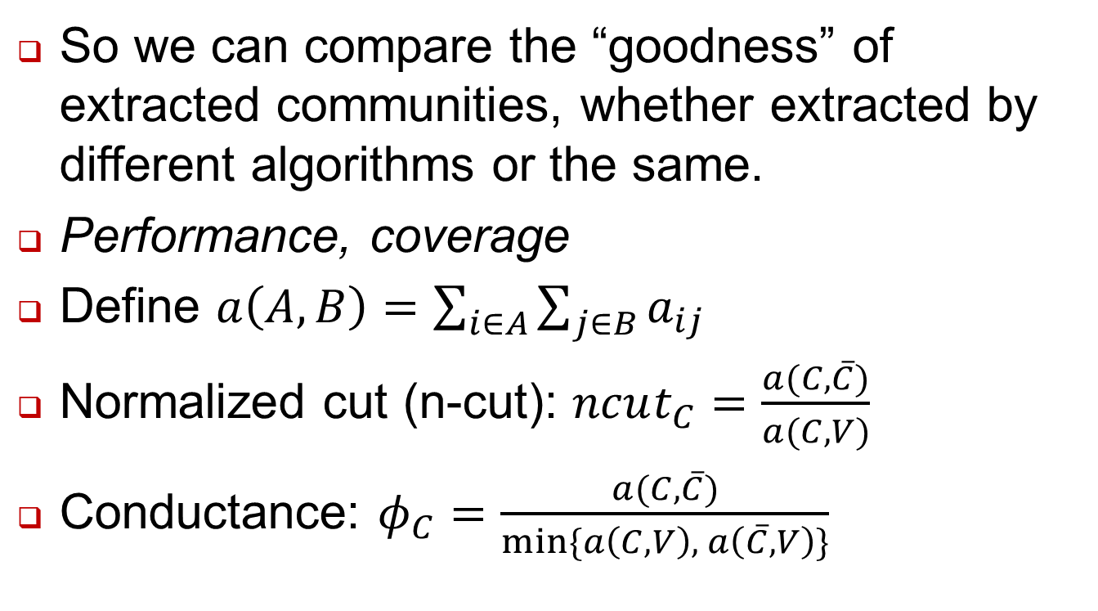
Evaluating Community Quality (Sec. 3)
So we can compare the “goodness” of extracted communities, whether extracted by different algorithms or the same.
Performance, coverage
Define $a\left(A, B\right)=\sum_{i∈A}{\sum_{j∈B}{a_{ij}}}$
Normalized cut (n-cut): $ncut_{C}=\frac{a(C, \overline{C})}{a(C, V)}$
Conductance: $φ_{C}=\frac{a(C, \overline{C})}{min⁡\{a\left(C, V\right), a\left(\overline{C}, V\right)\}}$

Slide 15
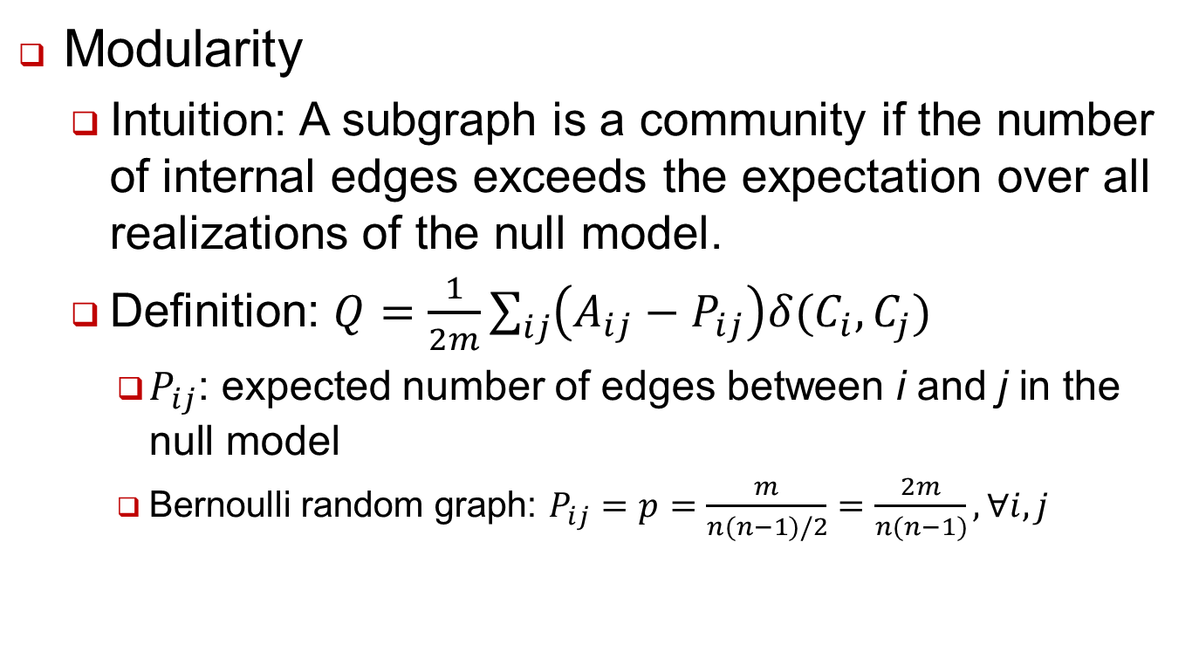
Evaluating Community Quality (Sec. 3)
Modularity
Intuition: A subgraph is a community if the number of internal edges exceeds the expectation over all realizations of the null model.
Definition: $Q=\frac{1}{2m}\sum_{ij}{\left(A_{ij}−P_{ij}\right)δ(C_{i},C_{j})}$
$P_{ij}$: expected number of edges between i and j in the null model
Bernoulli random graph: $P_{ij}=p=\frac{m}{n(n−1)/2}=\frac{2m}{n(n−1)}, ∀i,j$

Slide 16
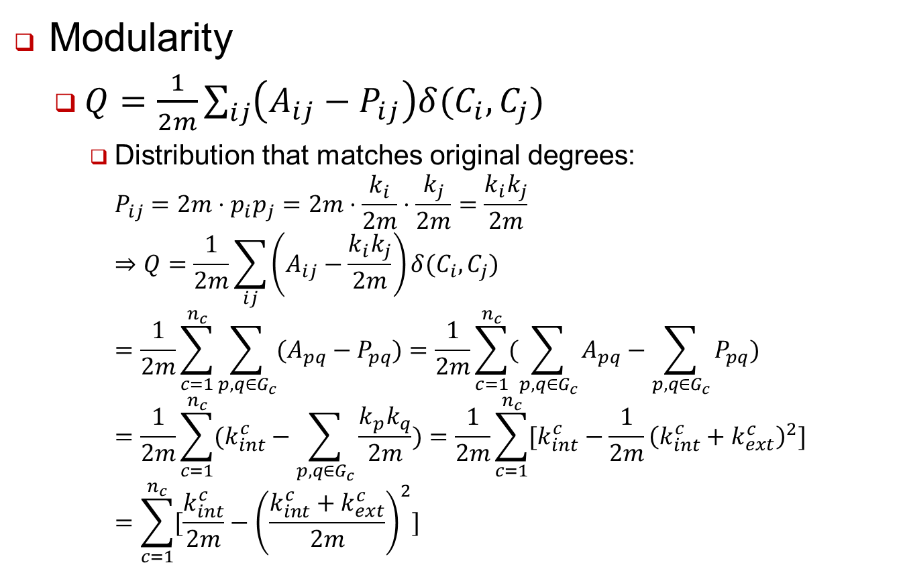
Evaluating Community Quality (Sec. 3)
Modularity
$Q=\frac{1}{2m}\sum_{ij}{\left(A_{ij}−P_{ij}\right)δ(C_{i},C_{j})}$
Distribution that matches original degrees: $P_{ij}=2m⋅p_{i}p_{j}=2m⋅\frac{k_{i}}{2m}⋅\frac{k_{j}}{2m}=\frac{k_{i}k_{j}}{2m}$ $⇒Q=\frac{1}{2m}\sum_{ij}{\left(A_{ij}−\frac{k_{i}k_{j}}{2m}\right)δ(C_{i},C_{j})}$ $=\frac{1}{2m}\sum_{c=1}^{n_{c}}{\sum_{p,q∈G_{c}}{(A_{pq}−P_{pq})}}=\frac{1}{2m}\sum_{c=1}^{n_{c}}{(\sum_{p,q∈G_{c}}{A_{pq}}−\sum_{p,q∈G_{c}}{P_{pq}})}$ $=\frac{1}{2m}\sum_{c=1}^{n_{c}}{(k_{int}^{c}−\sum_{p,q∈G_{c}}{\frac{k_{p}k_{q}}{2m}})}=\frac{1}{2m}\sum_{c=1}^{n_{c}}{[k_{int}^{c}−\frac{1}{2m}{\left(k_{int}^{c}+k_{ext}^{c}\right)}^{2}]}$ $=\sum_{c=1}^{n_{c}}{[\frac{k_{int}^{c}}{2m}−{\left(\frac{k_{int}^{c}+k_{ext}^{c}}{2m}\right)}^{2}]}$

Slide 17
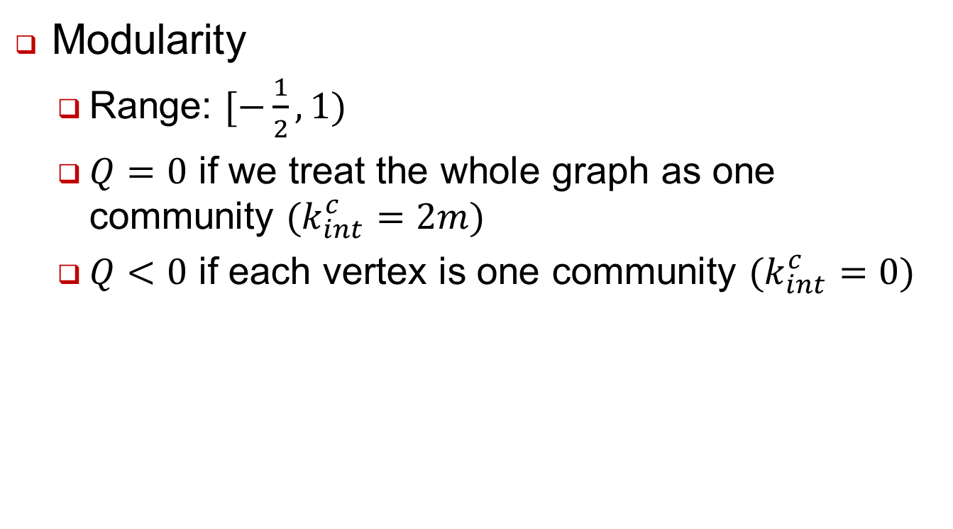
Evaluating Community Quality (Sec. 3)
Modularity
Range: $[−\frac{1}{2}, 1)$
$Q=0$ if we treat the whole graph as one community $(k_{int}^{c}=2m)$
$Q<0$ if each vertex is one community $(k_{int}^{c}=0)$

Slide 18
Traditional Methods (Sec. 4)
Graph Partitioning
Dividing vertices into groups of predefined size
Kernighan-Lin algorithm
Create initial bisection
Iteratively swap subsets containing equal number of vertices
Select the partition that maximize (number of edges insider modules – cut size)

Slide 19
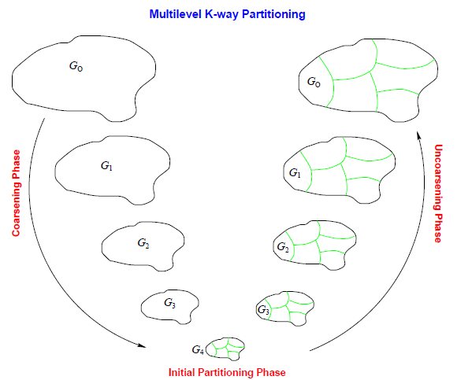
Traditional Methods (Sec. 4)
Graph Partitioning
METIS (Karypis and Kumar)
Multi-level approach
Coarsen the graph into skeleton
Perform K-L and other heuristics on the skeleton
Project back with local refinement

Slide 20
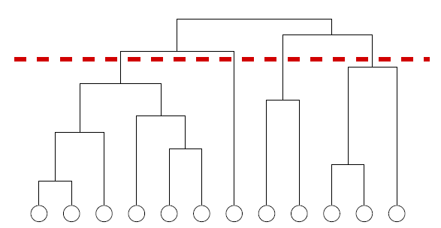
Traditional Methods (Sec. 4)
Hierarchical Clustering
Graphs may have hierarchical structure

Slide 21
Traditional Methods (Sec. 4)
Hierarchical Clustering
Find clusters using a similarity matrix
Agglomerative: clusters are iteratively merged if their similarity is sufficiently high
Divisive: clusters are iteratively split by removing edges with low similarity
Define similarity between clusters
Single linkage (minimum element)
Complete linkage (maximum element)
Average linkage
Drawback: dependent on similarity threshold

Slide 22
Traditional Methods (Sec. 4)
Partitional Clustering
Embed vertices in a metric space, and find clustering that optimizes the cost function
Minimum k-clustering
k-clustering sum
k-center
k-median
k-means
Fuzzy k-means

Slide 23
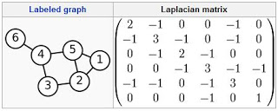
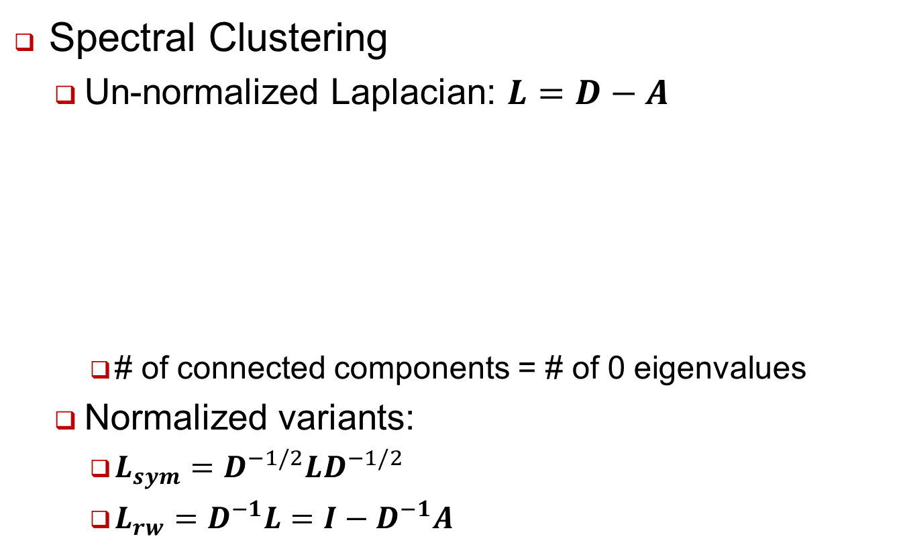
Traditional Methods (Sec. 4)
Spectral Clustering
Un-normalized Laplacian: $L=D−A$
# of connected components = # of 0 eigenvalues
Normalized variants:
$L_{sym}=D^{−1/2}LD^{−1/2}$
$L_{rw}=D^{−1}L=I−D^{−1}A$

Slide 24
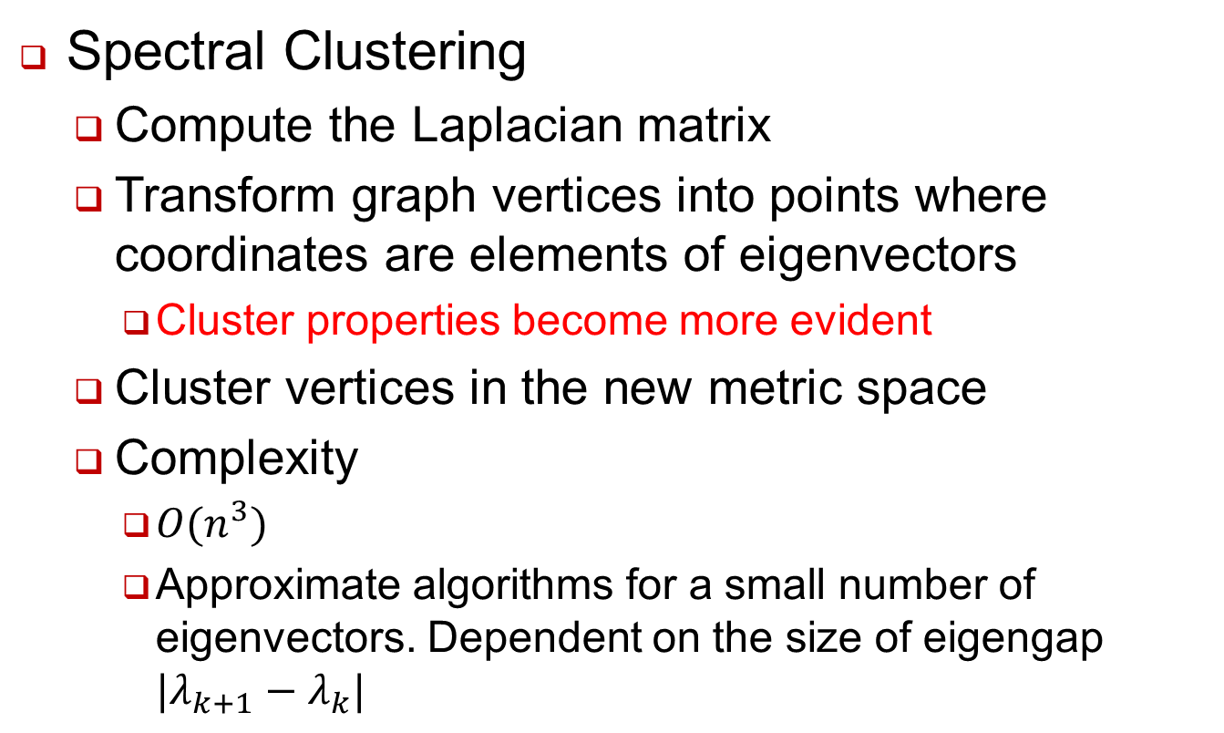
Traditional Methods (Sec. 4)
Spectral Clustering
Compute the Laplacian matrix
Transform graph vertices into points where coordinates are elements of eigenvectors
Cluster properties become more evident
Cluster vertices in the new metric space
Complexity
$O(n^{3})$
Approximate algorithms for a small number of eigenvectors. Dependent on the size of eigengap $|λ_{k+1}−λ_{k}|$

Slide 25
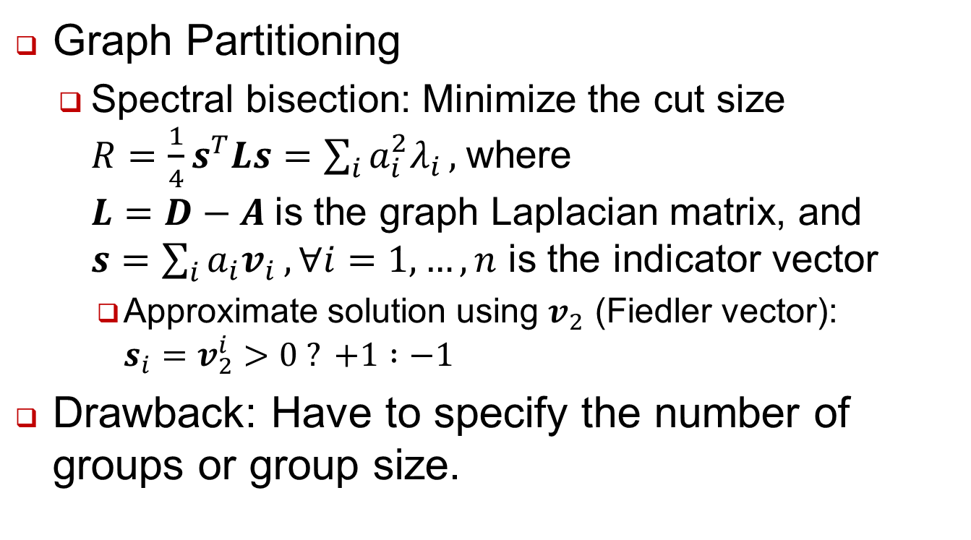
Traditional Methods (Sec. 4)
Graph Partitioning
Spectral bisection: Minimize the cut size $R=\frac{1}{4}s^{T}Ls=\sum_{i}{a_{i}^{2}λ_{i}},$where $L=D−A$is the graph Laplacian matrix, and $s=\sum_{i}{a_{i}v_{i}}, ∀i=1,…,n$ is the indicator vector
Approximate solution using $v_{2}$ (Fiedler vector): $s_{i}=v_{2}^{i}>0 ? +1 :−1$
Drawback: Have to specify the number of groups or group size.
Ref: http://www.cs.berkeley.edu/~demmel/cs267/lecture20/lecture20.html

Slide 26
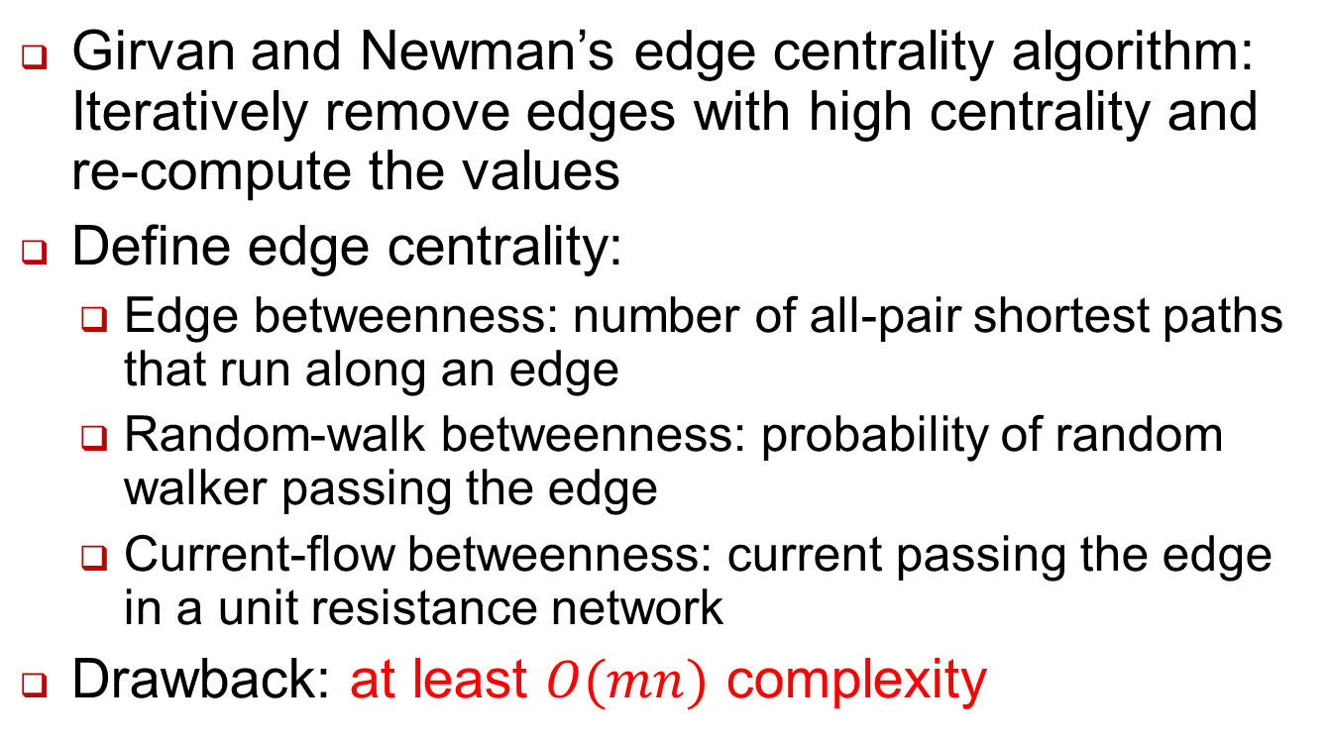
Divisive Algorithms (Sec. 5)
Girvan and Newman’s edge centrality algorithm: Iteratively remove edges with high centrality and re-compute the values
Define edge centrality:
Edge betweenness: number of all-pair shortest paths that run along an edge
Random-walk betweenness: probability of random walker passing the edge
Current-flow betweenness: current passing the edge in a unit resistance network
Drawback: at least $O(mn)$ complexity

Slide 27
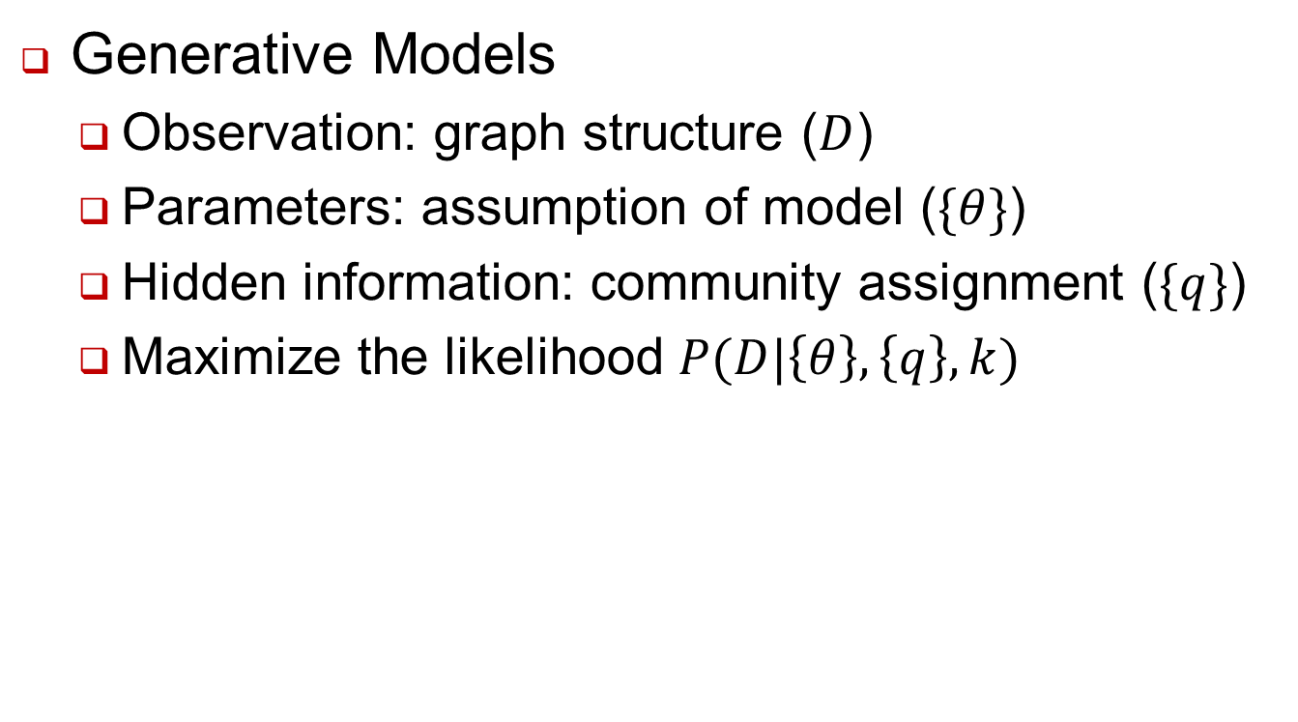
Statistical Inference (Sec. 9)
Generative Models
Observation: graph structure ($D$)
Parameters: assumption of model ($\{θ\}$)
Hidden information: community assignment ($\{q\}$)
Maximize the likelihood $P(D|\left\{θ\right\},\left\{q\right\},k)$

Slide 28
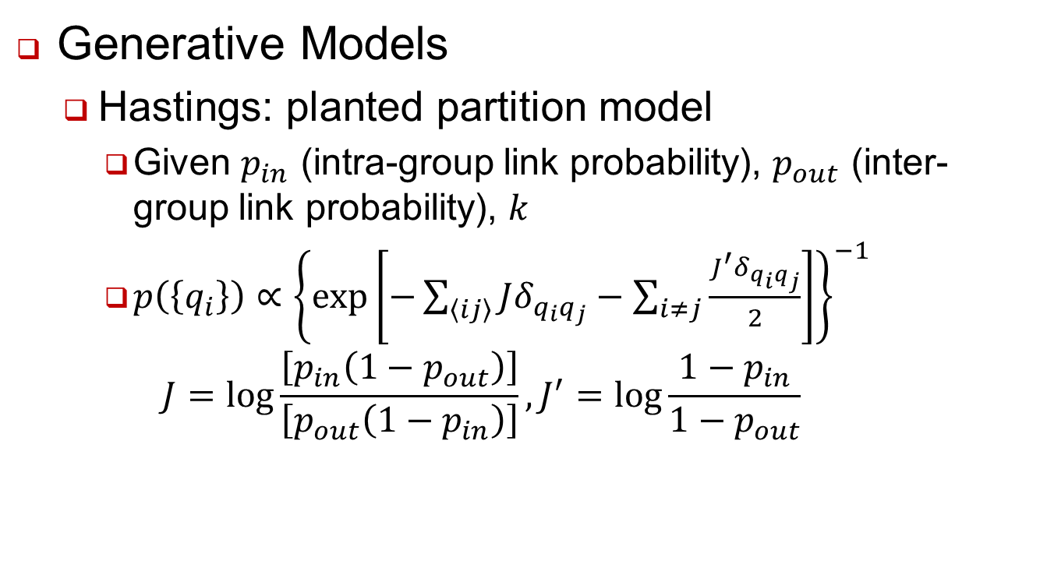
Statistical Inference (Sec. 9)
Generative Models
Hastings: planted partition model
Given $p_{in}$ (intra-group link probability), $p_{out}$ (inter-group link probability), $k$
$p\left(\left\{q_{i}\right\}\right)∝{\left\{\exp\left[−\sum_{\left\langle ij\right\rangle }{Jδ_{q_{i}q_{j}}}−\sum_{i≠j}{\frac{J^{′}δ_{q_{i}q_{j}}}{2}}\right]\right\}}^{−1}$ $J=\log{\frac{\left[p_{in}\left(1−p_{out}\right)\right]}{\left[p_{out}\left(1−p_{in}\right)\right]}}, J^{′}=\log{\frac{1−p_{in}}{1−p_{out}}}$

Slide 29
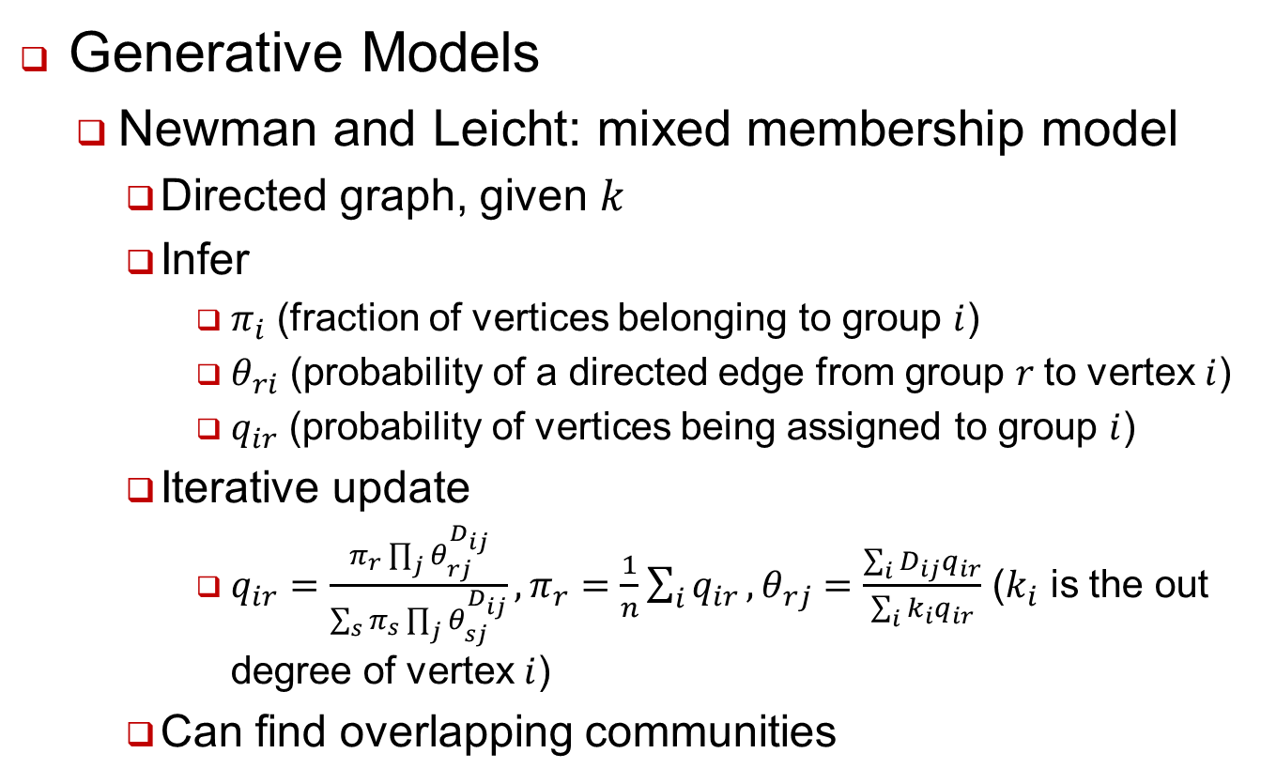
Statistical Inference (Sec. 9)
Generative Models
Newman and Leicht: mixed membership model
Directed graph, given $k$
Infer
$π_{i}$ (fraction of vertices belonging to group $i$)
$θ_{ri}$ (probability of a directed edge from group $r$to vertex $i$)
$q_{ir}$ (probability of vertices being assigned to group $i$)
Iterative update
$q_{ir}=\frac{π_{r}\prod_{j}{θ_{rj}^{D_{ij}}}}{\sum_{s}{π_{s}\prod_{j}{θ_{sj}^{D_{ij}}}}}, π_{r}=\frac{1}{n}\sum_{i}{q_{ir}}, θ_{rj}=\frac{\sum_{i}{D_{ij}q_{ir}}}{\sum_{i}{k_{i}q_{ir}}}$ ($k_{i}$ is the out degree of vertex $i$)
Can find overlapping communities

Slide 30
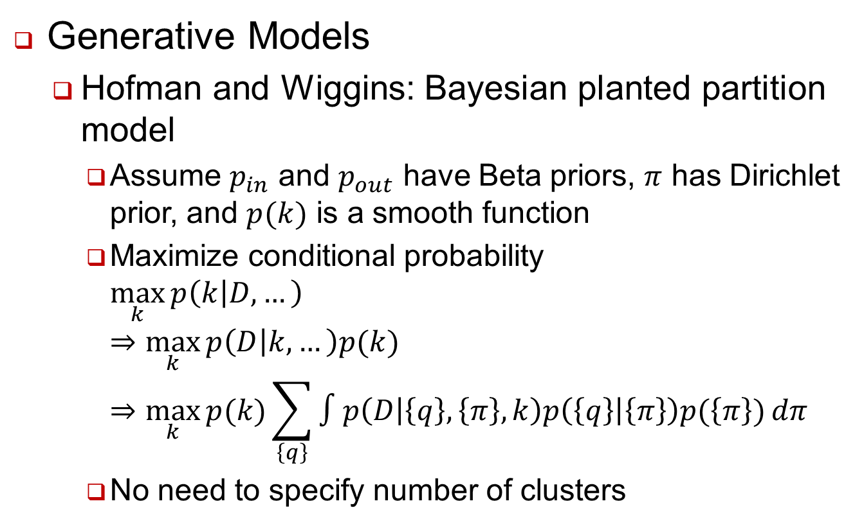
Statistical Inference (Sec. 9)
Generative Models
Hofman and Wiggins: Bayesian planted partition model
Assume $p_{in}$ and $p_{out}$ have Beta priors, $π$ has Dirichlet prior, and $p(k)$ is a smooth function
Maximize conditional probability $\max_{k}{p\left(k | D,…\right)}$ $⇒\max_{k}{p\left(D | k, …\right)p(k)}$ $⇒\max_{k}{p(k)\sum_{\left\{q\right\}}{∫p\left(D | \left\{q\right\},\left\{π\right\},k\right)p\left(\left\{q\right\} | \left\{π\right\}\right)p(\left\{π\right\})}dπ}$
No need to specify number of clusters

Slide 31
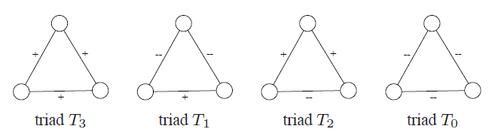
Signed Networks
Edges represent both positive and negative relations/interactions between vertices
Example: like/dislike function, member voting, …
Theories
Structural balance: three positive edges and one positive edge are more likely configurations
Social status: creator of positive link considers the recipient having higher status

Slide 32
Signed Networks
Leskovec, Huttenlocher, Kleinberg:
Compare the actual count of triangles with different configuration with expectation
Findings:
When networks are viewed as undirected, there is strong support for a weaker version of balance theory
Fewer-than-expected triangles with two positive edges
Over-represented triangles with three positive edges
When networks are viewed as directed, results follow the status theory better

Slide 33
Modularity based Methods
-BY MonADHIKA sHARMA

Slide 34
What is ‘Modularity’
Quality function to assess the usefulness of a certain partition
Based on the paper by Newman and Girvan
It is based on the idea that a random graph is not expected to have a cluster structure
to measure the strength of division of a network into ‘modules’
Modularity is the fraction of the edges that fall within the given groups minus the expected such fraction if edges were distributed at random

Slide 35
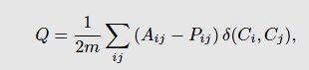
Modularity

Slide 36
Modularity based Methods
Try to Maximize Modularity
Finding the best value for Q is NP hard
Hence we use heuristics

Slide 37
1. Greedy Technique
Agglomerative hierarchical clustering method
Groups of vertices are successively joined to form larger communities such that modularity increases after the
merging.

Slide 38
2. Simulated Annealing
probabilistic procedure for global optimization
an exploration of the space of possible states, looking for the global optimum of a function F (say maximum)
Transition with 1 if increases, else with

Slide 39
3. Extremal Optimization
evolves a single solution and makes local modifications to the worst components
Uses ‘fitness value’ like in genetic algorithm
At each iteration, the vertex with the lowest fitness is shifted to the other cluster
Changes partition, fitness recalculated
Till we reach an optimum Q value

Slide 40
SPECTRAL ALGORITHMS
Spectral properties of graph matrices are frequently used to find partitions
properties of a graph in relationship to the characteristic polynomial, eigenvalues, and eigenvectors of matrices associated to the graph, such as its adjacency matrix or Laplacian Matrix

Slide 41
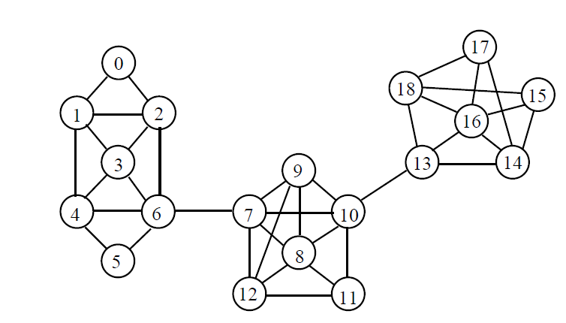
SPECTRAL ALGORITHMS
.

Slide 42
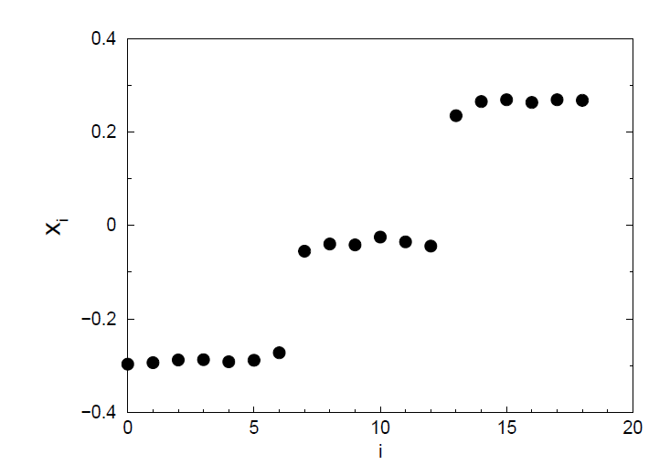
SPECTRAL ALGORITHMS

Slide 43
1. Spin models
A system of spins that can be in q different states
The interaction is ferromagnetic, i.e. it favors spin alignment
Interactions are between neighboring spins
Potts spin variables are assigned to the vertices of a graph with community structure

Slide 44
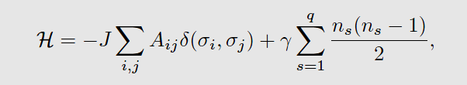
1. Spin models
The Hamiltonian of the model, i. e. its energy:

Slide 45
2. Random walk
A random walker spends a long time inside a community due to the high density of internal edges
E.g. 1 : Zhou used random walks to dene a distance between pairs of vertices
the distance between i and j is the average number of edges that a random walker has to cross to reach j starting from i.

Slide 46
3. Synchronization
In a synchronized state, the units of the system are in the same or similar state(s) at every time
Oscillators in the same community synchronize first, whereas a full synchronization requires a longer time
First used Kuramoto oscillators which are coupled two-dimensional vectors with a proper frequency of oscillations

Slide 47
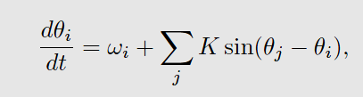
3. Synchronization
Phase of i
Natural frequency
Coupling coefficient
Runs over all oscillators

Slide 48
Overlapping community detection
Most of previous methods can only generate non-overlapped clusters.
A node only belongs to one community.
Not real in many scenarios.
A person usually belongs to multiple communities.
Most of current overlapping community detection algorithms can be categorized into three groups.
Mainly based on non-overlapping communities algorithms.

Slide 49
Overlapping community detection
1. Identifying bridge nodes
First, identifying bridge nodes and remove or duplicate these nodes.
Duplicate nodes have connection b/t them.
Then, apply hard clustering algorithm.
If bridge nodes was removed, add them back.
E.g. DECAFF [Li2007], Peacock [Gregory2009]
Cons: Only a small part of nodes can be identified as bridge nodes.
2
5
1
4
3
6
Notes:
cons: but actually, a large amount of proteins are multi-functional

Slide 50
Overlapping community detection
2. Line graph transformation
Edges become nodes.
New nodes have connection if they originally share a node.
Then, apply hard clustering algorithm on the line graph.
E.g. LinkCommunity [Ahn2010]
Cons: An edge can only belong to one cluster
1
2
4
6
5
1
4
3
8
2
3
7
6
5
Notes:
3. cons: given the PPI networks are usually very noisy.

Slide 51
Overlapping community detection
3. Local clustering
(optional) Select seed nodes.
Expand seed node according to some criterion.
E.g. ClusterOne [Nepusz2012], MCODE [Bader2003], CPM [Adamcsek2006], RRW [Macropol2009]
Cons: Not globally consider the topology
2
5
1
4
3
6

Slide 52
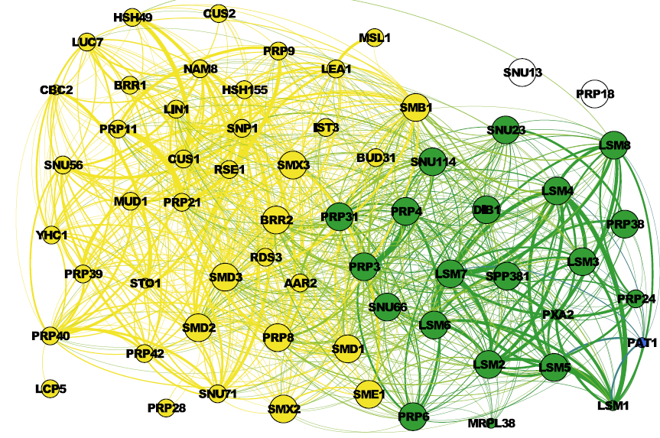
Multi-resolution methods
Many graphs have a hierarchical cluster structure.

Slide 53
Multi-resolution / Hierarchical methods
Most of previous methods can only generate a clustering with fixed resolution (avg. cluster size)
Clusters might be hierarchical or users might be interesting in different resolutions.
Multi-resolution methods
Produce clusterings with different average cluster size.
Hierarchical Clustering
Produce a dendrogram, showing the hierarchical clusters.

Slide 54
Multi-resolution methods
Has a parameter to change the average cluster size.
Pons (2006) and Arenas et al. (2008) introduce a new parameter in the modularity objective function.
Lancichinetti et al. (2009) designed a fitness function.
To detect overlapping clusters in multi-resolutions.
Pros: Good for clusters w/o hierarchy.
Cons: Need to rerun the algorithms to generate different resolutions.

Slide 55
Hierarchical Methods
Sales-Pardo et al. (2007) propose a top-down approach.
Can iteratively determine a graph has 0/1/2+ communities.
some nodes can belong to no cluster, corresponding to the real situation.
Pros: Help understand the hierarchy among clusters.
Cons: Hard to evaluate the dendrogram.

Slide 56
Dynamic community
Cluster each snapshot independently
Then mapping clusters in each clustering.
If two clusters in continuous snapshots share most of nodes, then the next one evolves from the previous one.
Detect the evolution of communities in a dynamic graph.
Birth, Death, Growth, Contraction, Merge, Split.

Slide 57
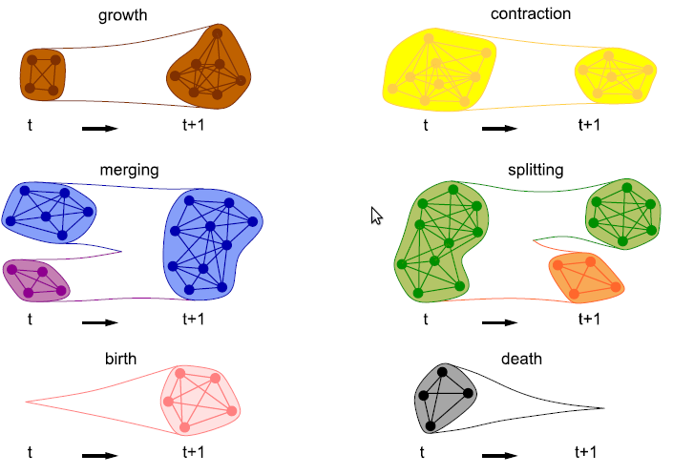
Dynamic community

Slide 58
Dynamic community
Asur et al. (2007) further detect a event involving nodes.
E.g. join and leave
Measure the node behavior.
Sociability: How frequently a node join and leave a community.
Influence: How a node can influence other nodes’ activities.
Usage
Understand the community behavior.
E.g. age is positively correlated with the size.
Predict the evolution of a community
Predict node (user) behavior, predict link

Slide 59
Dynamic community detection
Hypothesis: Communities in dynamic graphs are “smooth”.
Detect communities by also considering the previous snapshots.
Chakrabarti et al (2006) introduce history cost.
Measures the dissimilarity between two clusterings in continuous timestamps.
A smooth clustering has lower history cost.
Add this cost to the objective function.

Slide 60
Testing algorithms
1. Real data w/o gold standards:
2. Read data w/ gold standard
3. Synthetic data
Hard to say which algorithm is the best.
In different scenarios, different algorithms might be best choices.
1 and 2 are practical, but hard to determine which kinds of graphs / clusters an algorithm is suitable.
Sparse/Dense, power-law, overlapping communities.

Slide 61
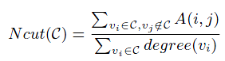
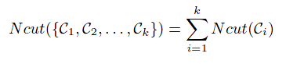
Real data w/o gold standards
Almeida et al. (2011) discuss many metrics.
Modularity, normalized cut, Silhouette Index, conductance, etc.
Each metric has its own bias.
Modularity, conductance are biased toward small number of clusters.
Should not choose the algorithms which is designed for that metric, e.g. modularity-based method.

Slide 62
Real data w/ gold standard
Examples of gold standard clusters
“Network”tags in Facebook.
Article tags in Wiki
Protein annotations.
Evaluate how closely the clusters are matched to the gold standard.
Cons: Overfitting – biased towards the clustering with similar cluster size.
Cons: Gold standard might be noisy, incomplete.

Slide 63
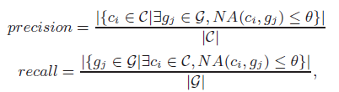
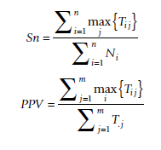
Metrics
F-measure
Harmonic mean of precision and recall
Need a parameter θ (usually 0.25)
Accuracy
Square root of PPV * Sn
T_{ij}: common nodes in community I and cluster j

Slide 64
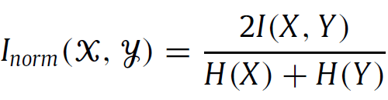
Metrics
Normalized Mutual Information
H(X): Entropy of X
I(X, Y): H(X) – H(X|Y), H(X|Y) is the conditional entropy
Some metrics need to be adjusted for overlapping clustering.
Notes:
From information theory

Slide 65
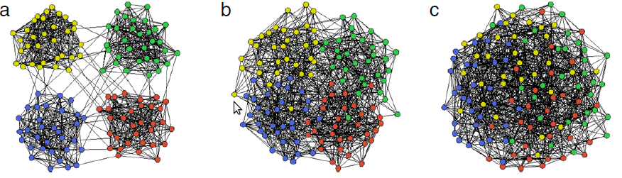
Synthetic data
Girvan and Newman (2002) Benchmark
Fixed 128 nodes and 4 communities
Can tune noisy level
Cons: All nodes have the same expected degree; All communities have the same size, etc

Slide 66
Synthetic data
LFR (Lancichinetti 2009)
Generate power-law, weighted/unweighted, directed/undirected graph with gold standard
Pros: can generate variaous graphs.
# nodes, average degree, power-law exponent.
Average/Min/Max community size, # bridge nodes.
Noisy level, etc.
Cons: The number of communities each bridge nodes belonging to is fixed.
Use the above metrics to evaluate the result.

Slide 67

Biological Application
Protein-protein interaction (PPI) network
Node: Protein; Edge: Interaction
Edge weight: Confidence level of an interaction
Interacting proteins are likely to have the same function.
Community: Protein complex or functional module
Gene Ontology terms, etc.
Usage: Predict functions of each protein
Biologically examining each protein is expensive
Improve drug design, etc.

Slide 68
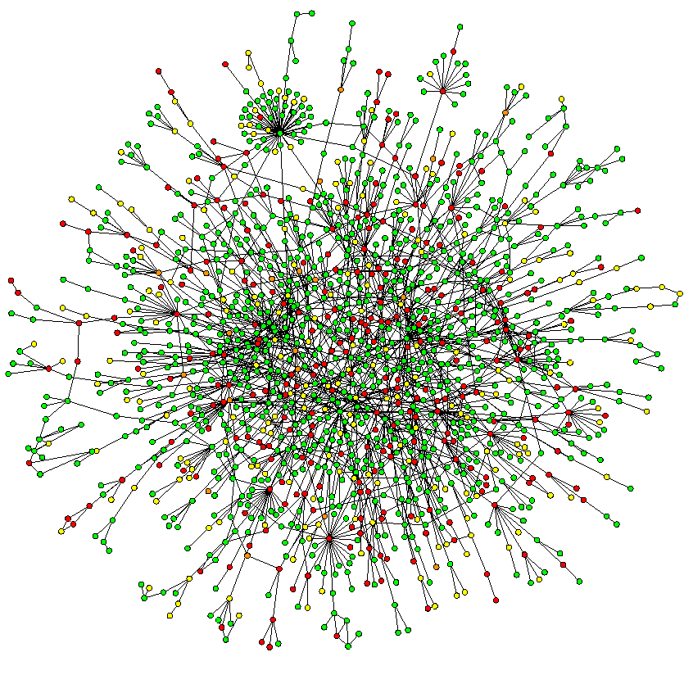
PPI networks
Usually thousands of nodes.
Each dataset, organism has a different network.
average degree 5~10.
power-law distribution.

Slide 69
PPI sub-network example

Slide 70
Biological Application
Must overlapping clustering
A protein has many functions.
Protein function is hierarchical
But a large function might not form a community.
Gold standard is far from complete
Yeast is the most annotated organism.
PPIs are very noisy
False positive and false negative
Better to integrate more evidence, e.g. sequence, gene expression profile.

Slide 71
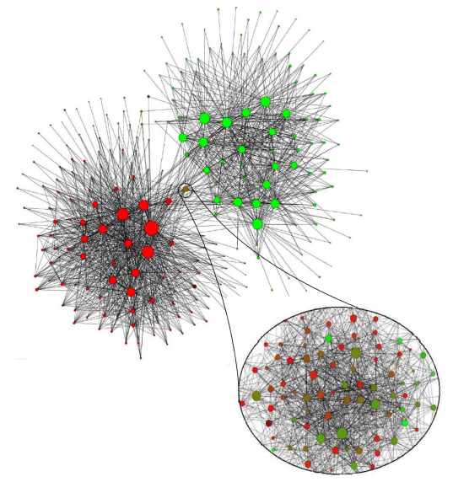
Applications (Sec. 17)
Social Networks
Belgian phone call network distinguishes French- and Dutch-speaking population

Slide 72
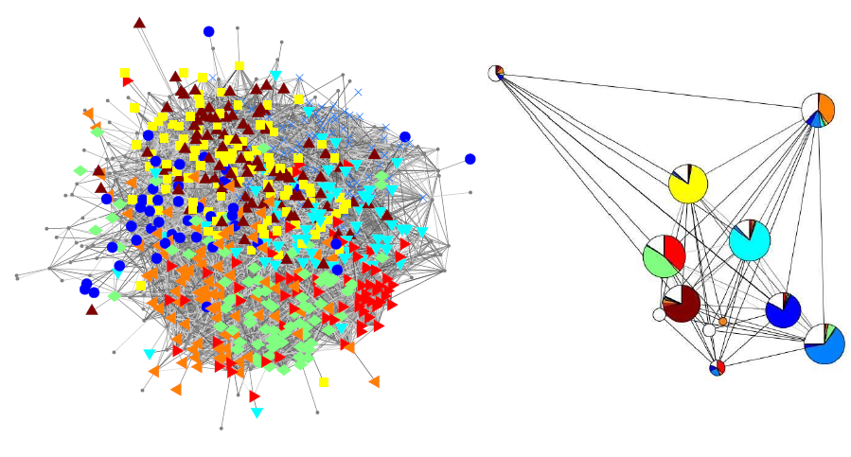
Applications (Sec. 17)
Social Networks
University students Facebook network (left) and corresponding dorm affiliation (right)

Slide 73
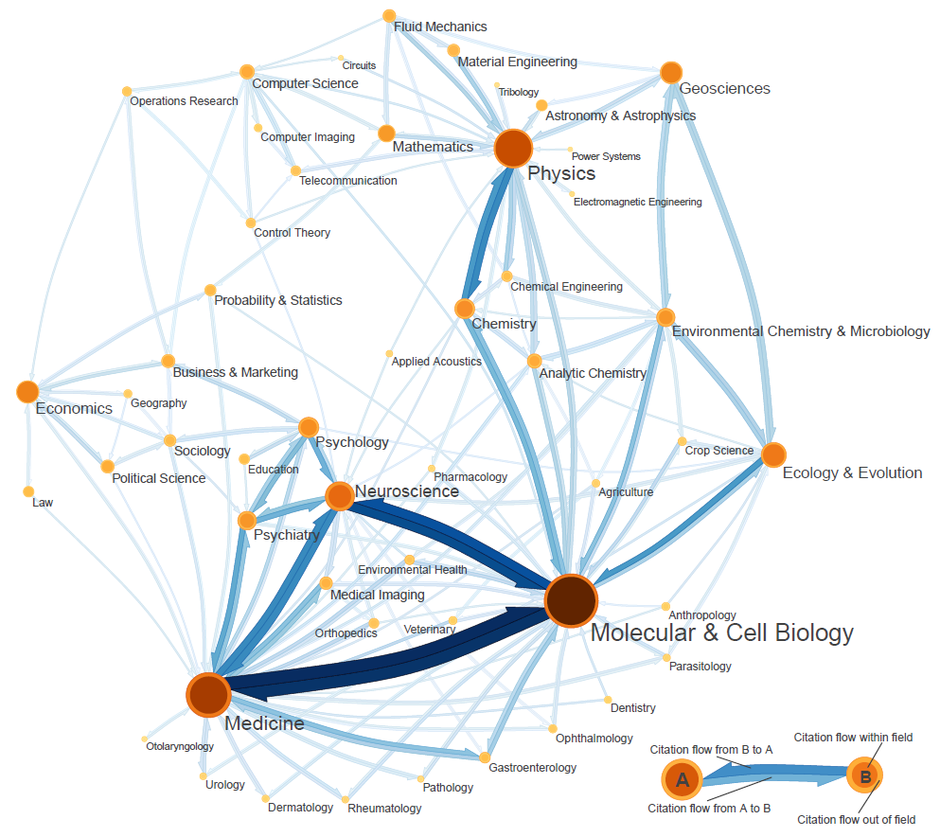
Applications (Sec. 17)
Other Networks
“Map of science” derived from citation network

